Slide 1
ARCHITECTURAL DETAILING ANDPLANNING,
FOR
EARTHQUAKE RESISTANT BUILDING
S.D.PATEL POLYTECHNIC GADHA
CIVIL ENGINEERING

Slide 2
ARCHITECHAR DETAILING AND PLANNING,
FOR
EARTHQUAKE RESISTANT BUILDING
GUIDED BY:
PROF. V.P.LUNJA
STUDENTS GROUP
PARMAR ANIL.B. (096690306043)
ZALA NARENDRA.V. (096690306017)
PUROHIT MOHIT.K. (096690306019)
PATEL PRIYANK.R. (096690306035)
PATEL CHIRAG.S (096690306030)

Slide 3
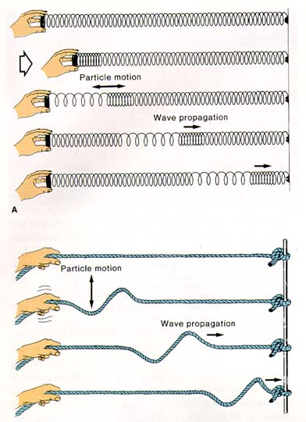
What is an earthquake? *IT IS A SUDDEN RELEASE OF ENERGY DUE TO SHIFTS OF EARTH’S PLATES
* IT IS STORED IN THE ROCK BELOW THE SURFESH OF EARTH
TREMBLING OR SHAKING OF THE GROUND IS CAUSED
ENRGY RELEASED TRAVELS IN WAVES KNOWN AS SEESMI WAVES
* TYPES OF SEISMIC WAVES
{ TWO TYPES}
1.BODY WAVES
travel through the interior of Earth primary waves
(P-waves)
2. SURFACE WAVES
travel on Earth's surface. secondary waves (s-waves).

Slide 4
The compression (push-pull) wave will vibrate parallel to the direction that the wave is traveling up to speeds of 4 to 8 km per second (2.49 to 4.35 miles per second). The S-wave vibrates perpendicular to the direction of travel and can travel up to speeds of 2 to 5 km per second ( 1.24 to 3.11 miles per second).
Love waves and Raleigh waves are known as Surface waves. Surface waves are the slowest of the seismic waves, but because they travel near the surface of Earth and contain a range of oscillating frequencies they often cause the most damage

Slide 5
The compression (push-pull) wave will vibrate parallel to the direction that the wave is traveling up to speeds of 4 to 8 km per second .
The S-wave vibrates perpendicular to the direction of travel and can travel up to speeds of 2 to 5 km per second .
Love waves and Raleigh waves are known as Surface waves.
*Surface waves are the slowest
* As they travel near the surface of Earth and contain oscillating frequencies cause the most damage

Slide 6
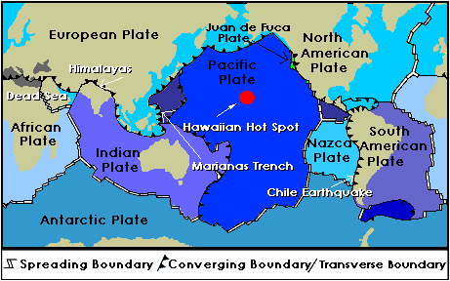

Slide 7
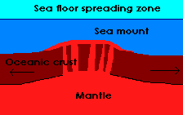
Plate Tectonics
A spreading boundary is where the tectonic plates are separating. These are places where volcanic activity is at a premium because the crust is being torn open (as in splitting and cracking, like an egg breaking open). New crust is forming when molten lava from deep down oozes out of the cracks where the plates are coming apart .

Slide 8
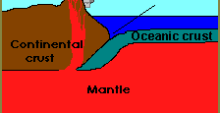
A converging boundary is when one plate (usually the lighter continental crust) rides up over the top of the other it's called a seduction zone - because one plate margin is being sub ducted under the other.

Slide 9
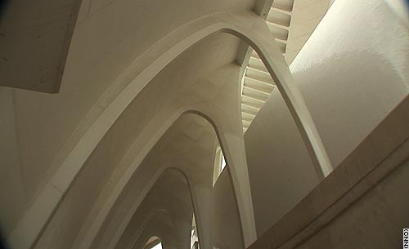
ARCHITECTS DESIGN BUILDINGS AND STRUCTURES.
They advise
-individuals,
-Property owners
-developers,
- community groups,
- local authorities
-commercial organizations
*on the design and construction of new buildings,
* reuse of existing buildings and the spaces which surround them.
ARCHITECTS WORK CLOSELY
with other members of the construction industry like
* engineers, builders, surveyors, local authority planners and building
control officers.
* time is spent visiting sites assessing the feasibility of a project, inspecting
building work or managing the construction process.
* Time is also spent researching old records and drawings, and
testing new ideas and construction techniques.
*Society looks
to architects for new and better ways of living and working,
to Develop innovative ways of using existing buildings and creating new ones.
Architects can be extremely influential and admired for their imagination and creative skills.

Slide 10
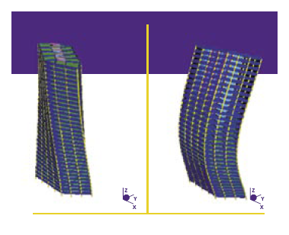
What do Structural Engineers do?
Structural engineering's combine their knowledge
of science and design making as they construct
better framework for buildings and other structures
*to safely resist natural and
made-made forces.
*They are involved
- physical testing,
- mathematical modeling,
-computer simulation
all of which support decisions that
Aid in the creation and maintenance
of safe and economical structures.

Slide 11
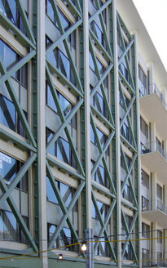
What is Earthquake Engineering?
Earthquake engineers are concerned with
creating earthquakes resistant designs and construction techniques to build of all kinds
of bridges, roads and buildings.
Earthquake engineers are faced with many uncertainties and thus he must be
smart in their decisions developing safe solutions to challenging problems.
They should rely on
state-of-the-art technology, materials science,
laboratory testing
field monitoring.

Slide 12
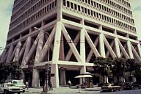
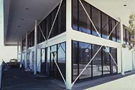

Earthquake-Resistant Structure
Building designed to prevent total collapse, preserve life, and minimize damages

Slide 13
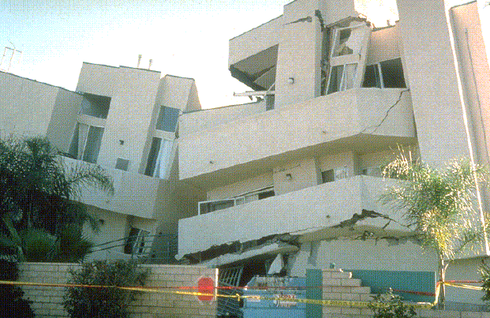

Slide 14
Building Configuration
IN ORDER TO MINIMIZE TORSION AND STRESS CONCENTRATION, PROVISIONS GIVEN SHOULD BE COMPLIED WITH AS RELEVANT
*The building should have a simple rectangular plan and be symmetrical both with respect to mass and rigidity
-To make the centers of mass and rigidity of the building coincide with each other in which case no separation sections other than expansion joints are necessary.
-For provision of expansion joints reference may be made to IS 3414 : 1968

Slide 15
Foundations
*The structure shall not be founded on such loose soils which will subside or liquefy during an earthquake, resulting in large differential settlements
*Loose fine sand, soft silt and expansive clays should be avoided.
If unavoidable,
-the building shall rest either on a rigid raft foundation or on piles taken to a firm stratum.
-However, for light constructions the following measures may be taken to improve the soil on which the foundation of the building may rest:
a) Sand piling, and
b) Soil stabilization

Slide 16
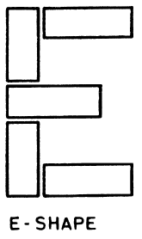
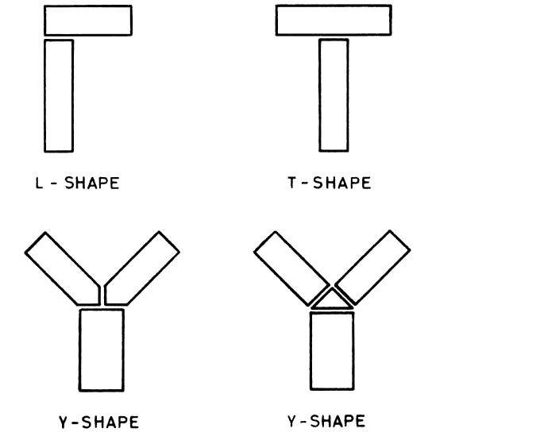
*Buildings having plans with shapes like, L, T, E and Y shall preferably be separated into rectangular parts by providing separation sections at appropriate places. Typical
examples are shown in

Slide 17
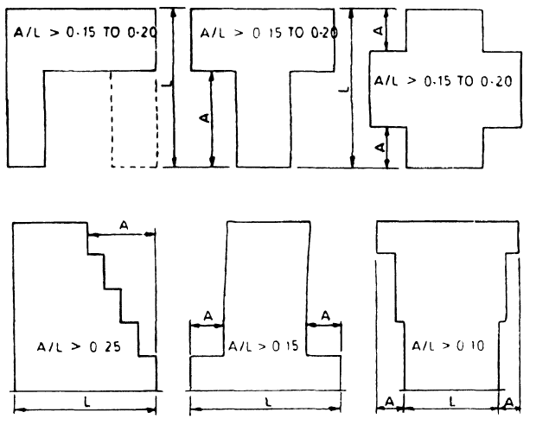
PLAN AND VERTICAL IRREGULARITIES

Slide 18
SPECIAL CONSTRUCTION FEATURES
Separation of Adjoining Structures
*Separation of adjoining structures or parts of the same structure is required for
structures having different total heights or storey heights
different dynamic characteristics.
THIS IS TO AVOID COLLISION DURING AN EARTHQUAKE

Slide 19
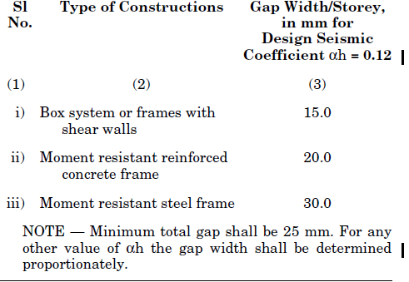
Gap Width for Adjoining Structures

Slide 20
STAIRCASES OF EARTHQUAKE
THE INTERCONNECTION OF THE STAIRS WITH THE ADJACENT FLOORS
- appropriately treated by providing sliding joints at the stairs to eliminate their bracing effect on the floors
*IN CASE OF LARGE STAIR HALLS
- IT SHOULD BE separated from the rest of the building by
means of separation or crumple sections.
*Three types of stair construction may be adopted as described below
i) Separated Staircases — One end of the
staircase rests on a wall and the other end is carried by columns and beams which have no connection with the floors.

Slide 21
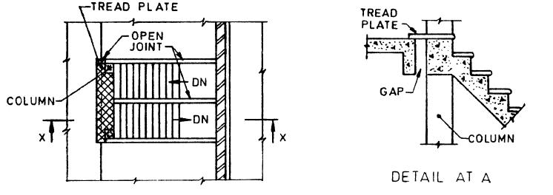
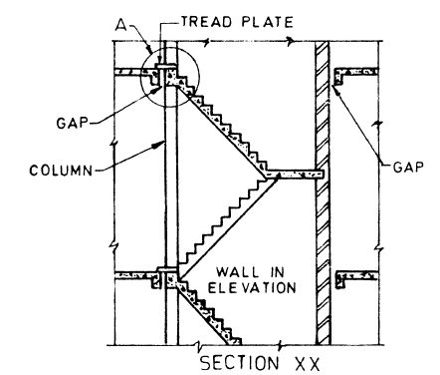

Slide 22
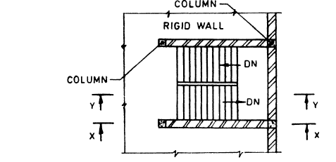
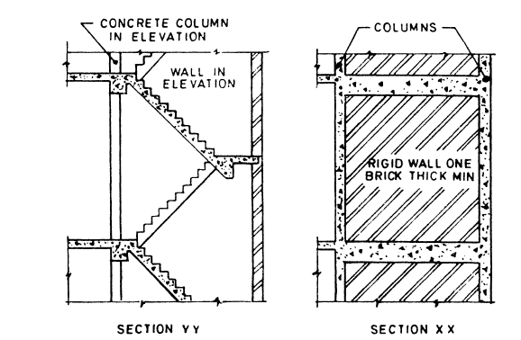
ii) Built-in Staircase — When stairs are built monolithically with floors,
-they can be protected against damage
-by providing rigid walls at the stair opening.
-An arrangement, in which the staircase is
enclosed by two walls, is given in Fig.
-In such cases, the joints,
as mentioned respect of separated staircases, will not be necessary.
-The two walls mentioned in enclosing
the staircase,
shall extend through the entire height of the stairs and to the building
foundations.

Slide 23
TYPES OF CONSTRUCTION
a) Framed construction,
.
This type of construction consists of frames
with flexible (hinged) joints and bracing
members. Steel multistoried building or
industrial frames and timber construction
b) Box type construction
This type of construction consists of
prefabricated or in situ masonry, concrete or
reinforced concrete wall along both the axes of
the building. The walls support vertical loads
and also act as shear walls for horizontal loads
acting in any direction. All traditional masonry
construction falls under this category.

Slide 24
CATEGORIES OF BUILDINGS
For the purpose of specifying the earthquake resisting features in masonry and
wooden buildings, the buildings have beencategorised in five categories A to E based on
the value of αh given by:
αh = αo I.β
αh = design seismic coefficient for the building,
αo = basic seismic coefficient for the seismic
zone in which the building is located
I = importance factor applicable to the
building
β = soil foundation factor
IS 1893 : 1984 ).

Slide 25
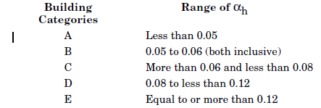
Building Categories for Earthquake Resisting Features

Slide 26
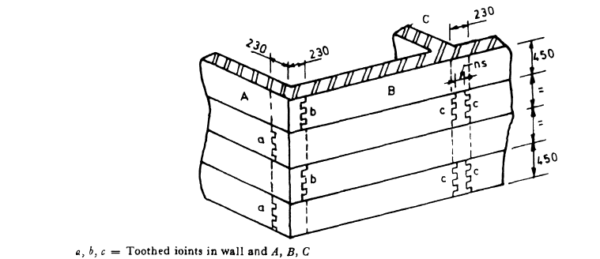
ALTERNATING TOOTHED JOINTS IN WALLS AT CORNER AND T-JUNCTION

Slide 27
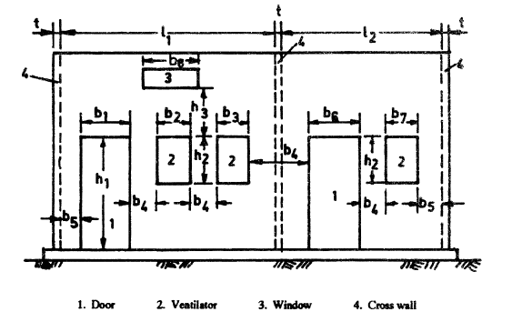
OPENINGS IN BEARING WALLS

Slide 28
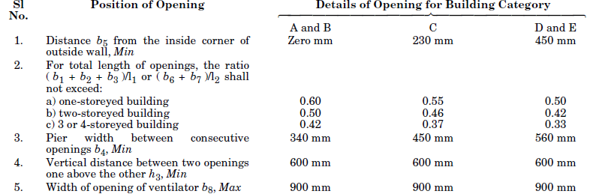

Slide 29
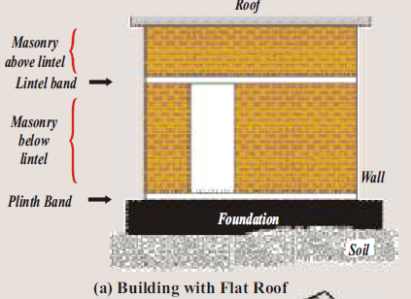

Slide 30
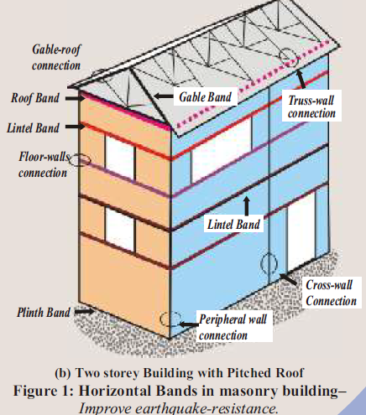

Slide 31
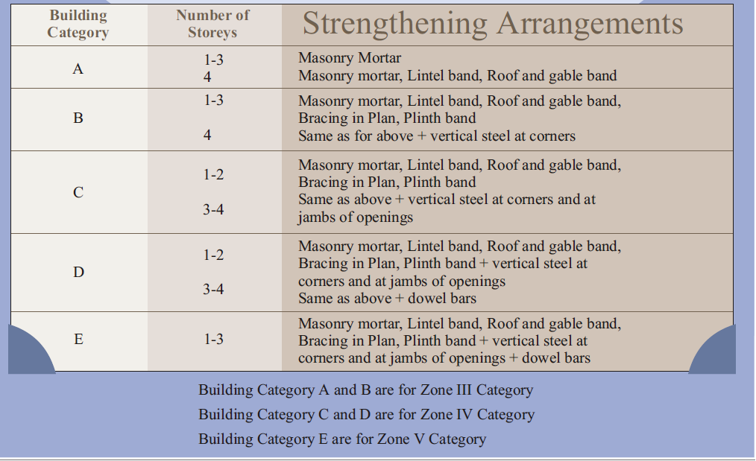

Slide 32
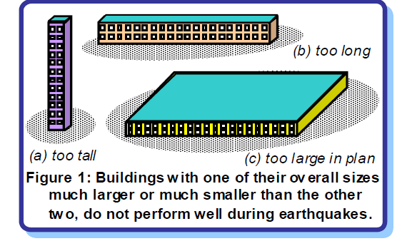
Size of Buildings
Se of Buildings

Slide 33
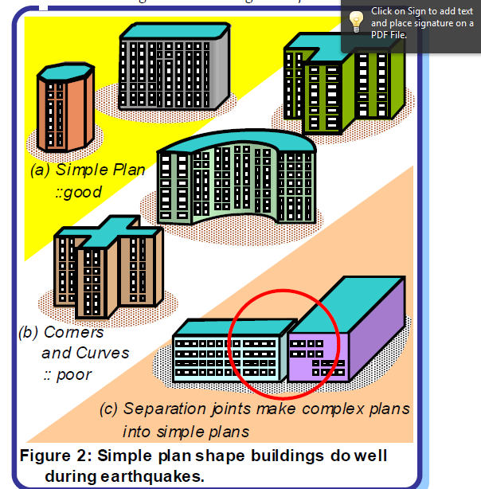
Horizontal Layout of Buildings

Slide 34
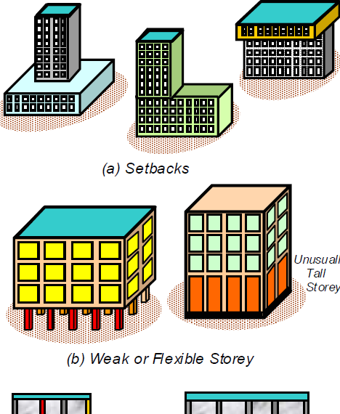
Vertical Layout of Buildings

Slide 35
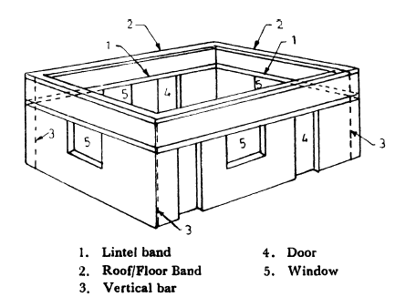
Section and Reinforcement of Band
The band shall be made of reinforced concrete of grade not leaner than M15 or reinforced brick-work in cement mortar not leaner than1 : 3. The bands shall be of the full width of the
wall, not less than 75 mm in depth and reinforced with steel.

Slide 36
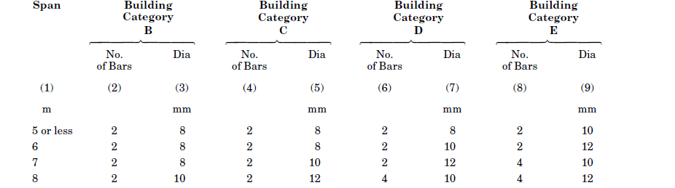
Recommended Longitudinal Steel in Reinforced Concrete Bands
NOTES
The number and diameter of bars given above pertain to high strength deformed bars. If plain mild-steel bars are used
keeping the same number, the following diameters may be used:

Slide 37
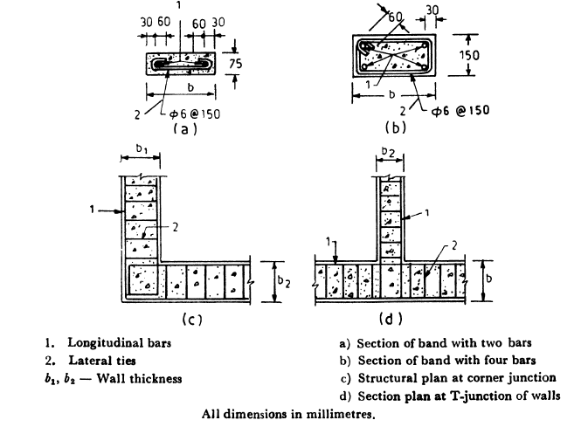
REINFORCEMENT AND BENDING DETAIL IN R. C. BAND

Slide 38
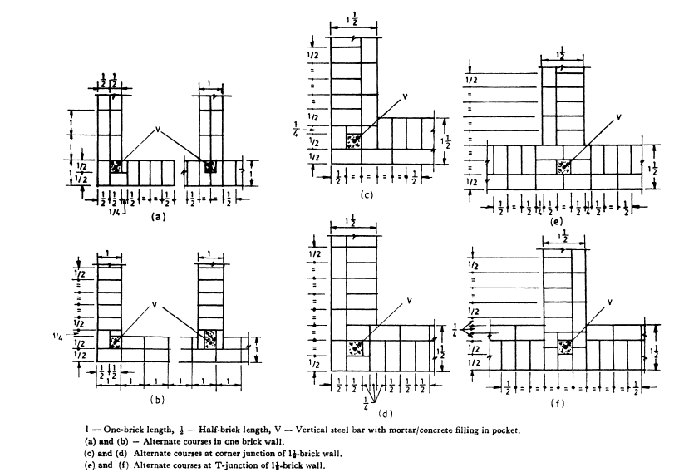
TYPICAL DETAILS OF PROVIDING VERTICAL STEEL BARS IN BRICK MASONRY

